Slide 1
CS 5402 Introduction to Data Mining
Attribute Selection
v.1
Perry B. Koob, koobp@mst.edu

Slide 2
What we are going to learn.
Scheme-independent Selection
Attribute Space Search
Scheme-specific Selection

Slide 3
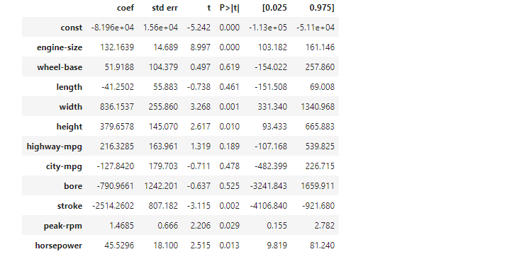
Attribute Selection
Having variables that are not relevant can impact model performance.
The desired model is a “parsimonious” model. This means the model has the most explanatory power with the smallest number of attributes.

Slide 4
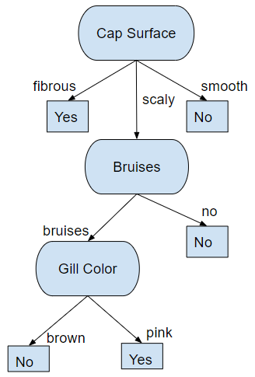
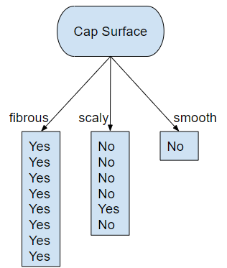
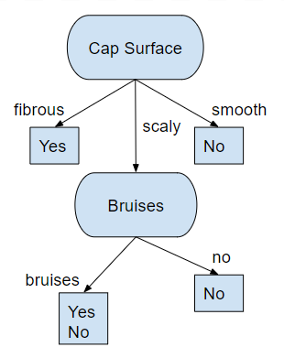
Attribute Selection
Models that split the data into smaller and smaller pieces, like decision trees, are more impacted by non-relevant variables.
This is called the “fragmentation” problem.

Slide 5
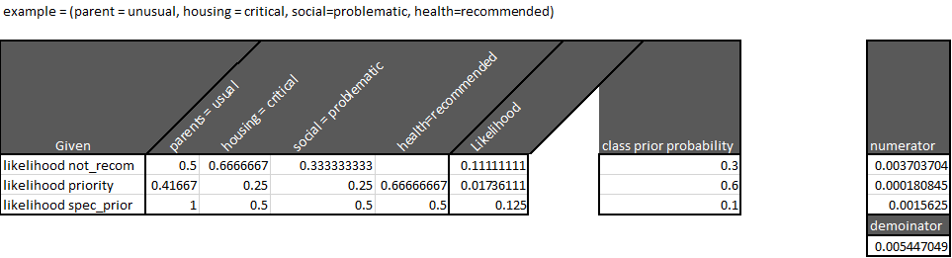
Attribute Selection
Models that evaluate all the data at once does not have “fragmentation” problem.
Though they still may have problems with non-relevant variables.

Slide 6
Attribute Selection
There are three approaches to handling attribute selection.
Scheme-independent Selection
Attribute Space Search
Scheme-specific Selection

Slide 7
Scheme-independent Selection
Scheme-independent selection uses a separate process to “filter”attributes than the learning scheme that will be used.
Approaches:
Use a “filter” method to determine the most promising subset of attributes.
Select the smallest set of attributes necessary to separate the dataset.
Recursive feature selection.
Instance based learning.

Slide 8
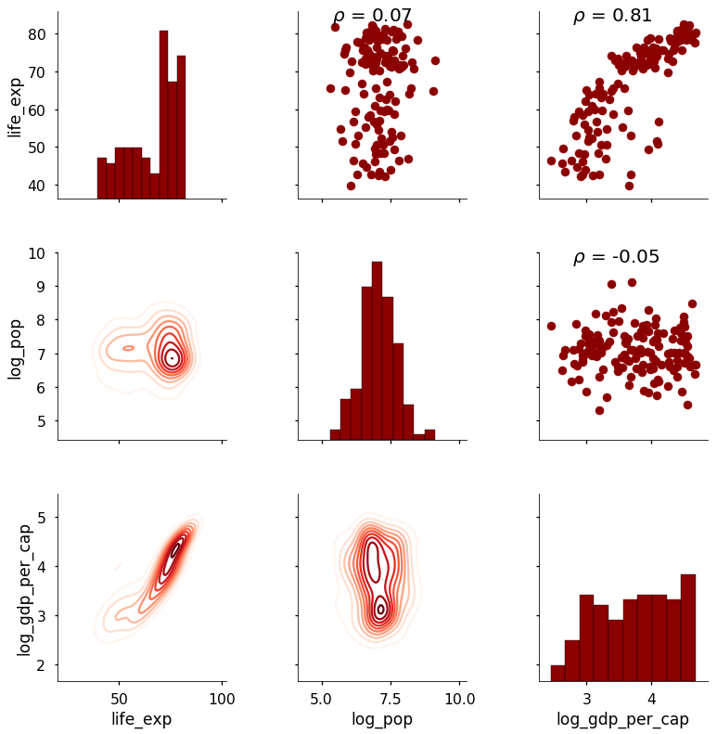
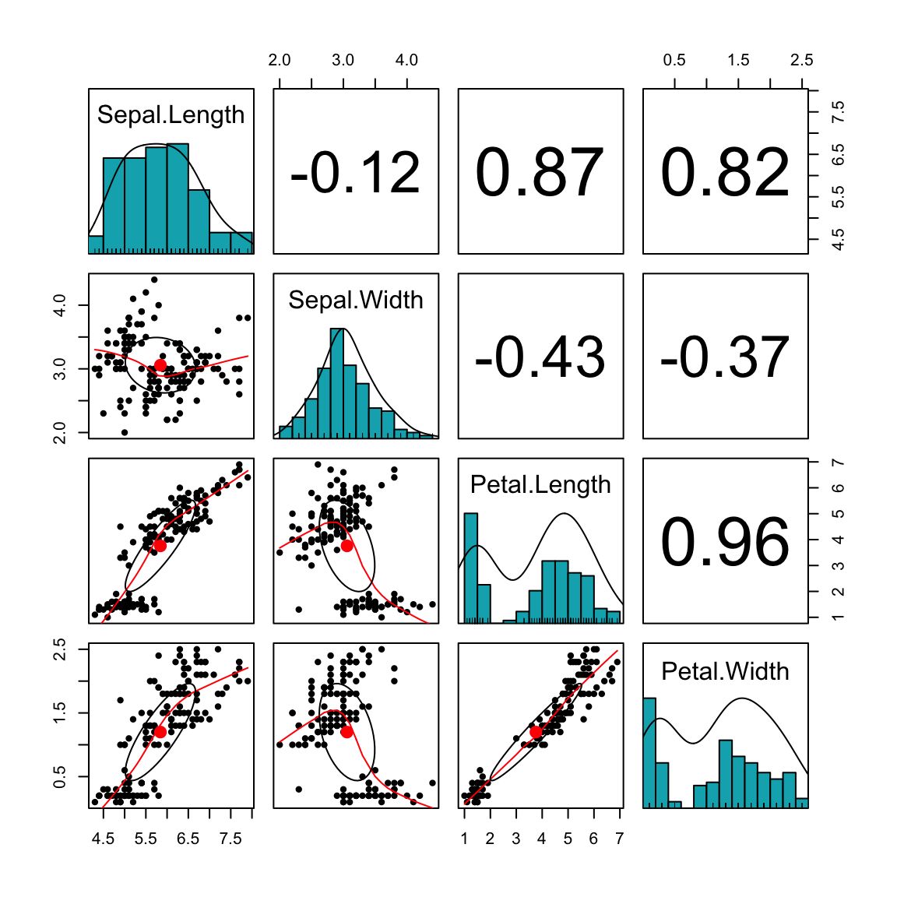
Scheme-independent Selection
Correlation between two attributes.
http://www.sthda.com/english/wiki/scatter-plot-matrices-r-base-graphs
https://towardsdatascience.com/visualizing-data-with-pair-plots-in-python-f228cf529166

Slide 9
Scheme-independent Selection
Correlation between two attributes can be determined with Pearson’s correlation.
Python
from scipy import stats
stats.pearsonr(x1, x2)
seaborn
R
cor(x1,x2,method=”pearson”)
pairs psych package
https://blogs.sas.com/content/iml/2011/08/26/visualizing-correlations-between-variables-in-sas.html

Slide 10
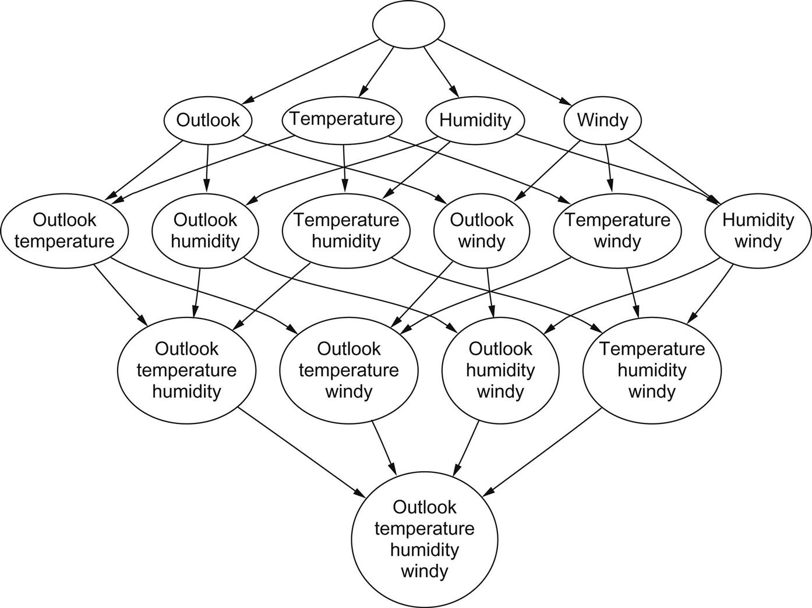
Attribute Space Search
Forward selection
Backward elimination

Slide 11
Attribute Space Search
Stepwise selection
Forward selection
Bidirectional selection
Backward elimination
Best-fit search
Beam search
Genetic algorithm search

Slide 12
Scheme-specific Selection
Scheme-specific selection uses a process that “wraps” around the learning scheme that will be used.
Cross-validation
Forward selection and Backward elimination
Race Search using Paired Statistical Significance Test between sets of classifiers.
Schemata search is a race search method based on randomly removed and added attributes

Slide 13
What we covered.
Attribute Selection
Scheme-independent Selection
Attribute Space Search
Scheme-specific Selection

Slide 14
References
Shmueli, G., Bruce, P. C., Yahav, I., Patel, N. R., & Lichtendahl Jr, K. C. (2017). Data mining for business analytics: concepts, techniques, and applications in R. John Wiley & Sons.
Witten, I. H., Frank, E., Hall, M. A., & Pal, C. J. (2016). Data Mining: Practical Machine Learning Tools and Techniques.

